Slide 1
GENDER AND AGE DETECTION
Team Members:
RA2011026010082-SINDHU KALEESWARAN
RA2011026010099-APARNA SURESH
RA2011026010113-CHEREDDY SOWMYA SRI

Slide 2
INTRODUCTION
Gender and age detection using deep learning is a technology that utilizes neural networks to recognize and classify an individual's age and gender based on an image.
The deep learning model uses convolutional neural networks (CNN) to extract relevant features from the input images and a fully connected layer to perform the classification task. The CNNs learn to detect patterns in the images and encode them into a feature vector, which is then fed into the fully connected layer for age and gender prediction.

Slide 3
PROBLEM STATEMENT
The problem statement for age and gender detection using deep learning is to develop a system that can accurately detect the age and gender of individuals from image. This involves training a deep learning model on a large dataset of images or videos that are labeled with the correct age and gender of the individuals depicted. The model should be able to accurately predict the age and gender of individuals from images.

Slide 4
APPROACH
The tasks tackled using the deep CNN approach include gender classification and age estimation. The basic structure includes a series of convolutional blocks, followed by a set of fully connected layers for classification and regression. Every architecture comprises convolutional blocks that are a stack of convolutional layers followed by non-linear activation 'ReLU', max pooling and batch normalization to mitigate the problem of covariate shift. Following the convolutional blocks, the output is flattened before feeding that into FC layers. These FC layers have activation function of ReLU, dropout (value 0.3) and batch normalization. During training, the CNN learns the optimal values for filter matrices that enable it to extract meaningful features from input feature.

Slide 5
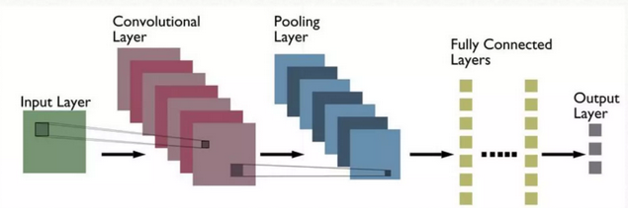
ARCHITECTURE DIAGRAM

Slide 6
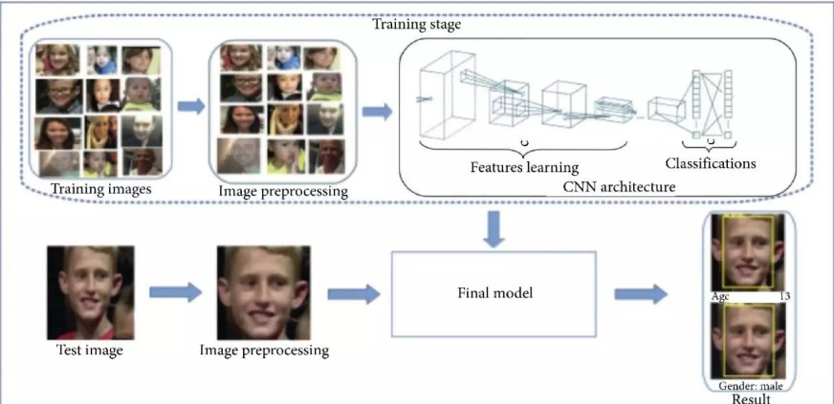

Slide 7
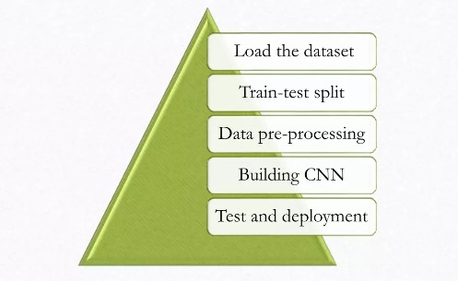
METHODOLOGY
Grayscale conversion
Resizing
Storing in numpy array
Normalizing

Slide 8
ALGORITHM
Data Collection: Collect a large dataset of images of human faces along with their gender and age labels. You can use publicly available datasets like UTKFace.
Data Preprocessing: Preprocess the dataset by resizing the images to a fixed size, converting them to grayscale, and normalizing the pixel values.
Splitting Dataset: Divide the dataset into three parts: training set, validation set, and testing set. The training set is used to train the model, the validation set is used to tune the model hyperparameters, and the testing set is used to evaluate the final model performance.
Gender Classification: Use the extracted features to train an MLP to classify the gender of the person in the image. The output of this model should be a binary class (male or female).

Slide 9
ALGORITHM
Age Estimation: Train another MLP to estimate the age of the person in the image. The output of this model should be a continuous value representing the estimated age.
Model Training and Evaluation: Train the gender and age estimation models using the training set and tune the hyperparameters using the validation set. Evaluate the final performance of the models using the testing set.
Deployment: Deploy the trained model to detect gender and estimate age from new images.

Slide 10
DATASET
UTKFace dataset is a large-scale face dataset with long age span (range from O to 116 years Old). It has a total of 23708 images. The images cover large variations in facial expression, illumination, pose, resolution and occlusion, We chose this dataset because of its relatively more uniform distributions, the diversity it has in image characteristics such as brightness, occlusion and position and also it involves images of the public data. Each image is labeled with a 2-element tuple, with age (in years), gender (Male-O. Female-I). We used the same set Of images for training, testing and validation, to have standardized results, This was done by dividing the data sets into train, test in 80 : 20 ratios.

Slide 11
DATASET
Link:
https://www.kaggle.com/datasets/jangedoo/utkface-new

Slide 12
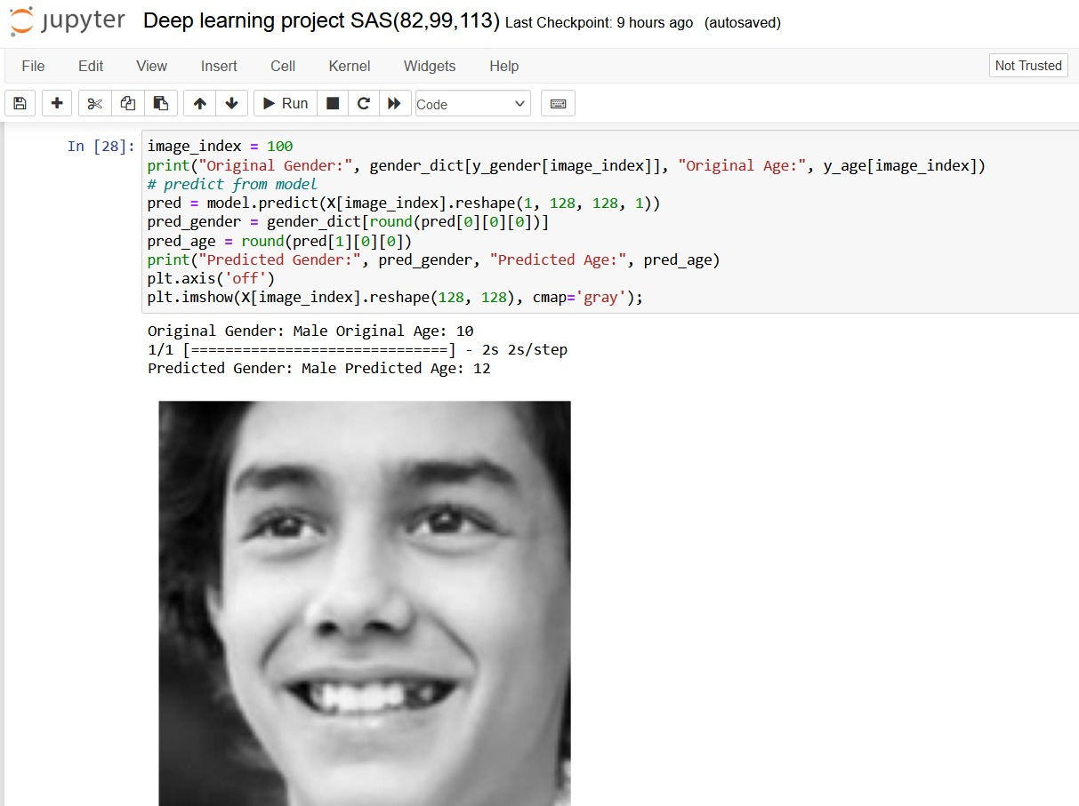
IMPLEMENTATION AND RESULT

Slide 13
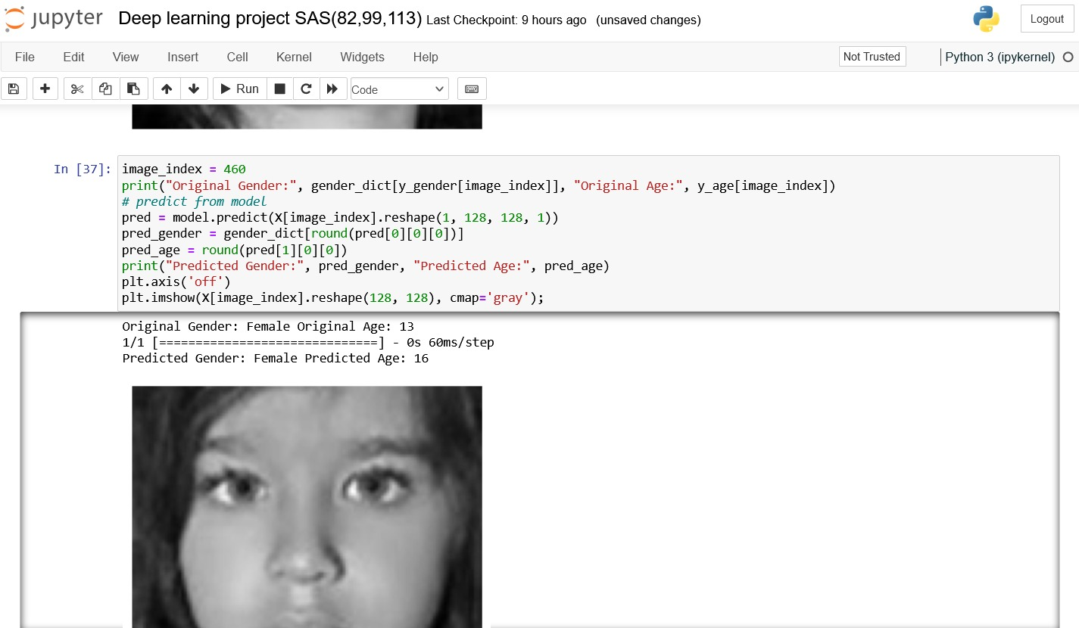

Slide 14
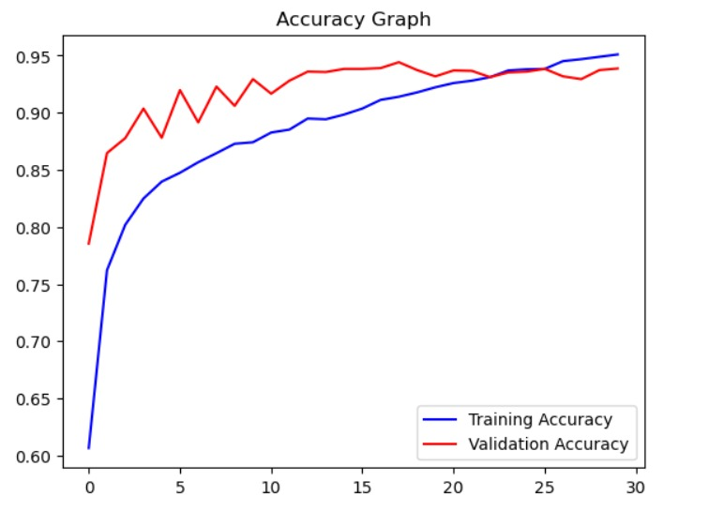
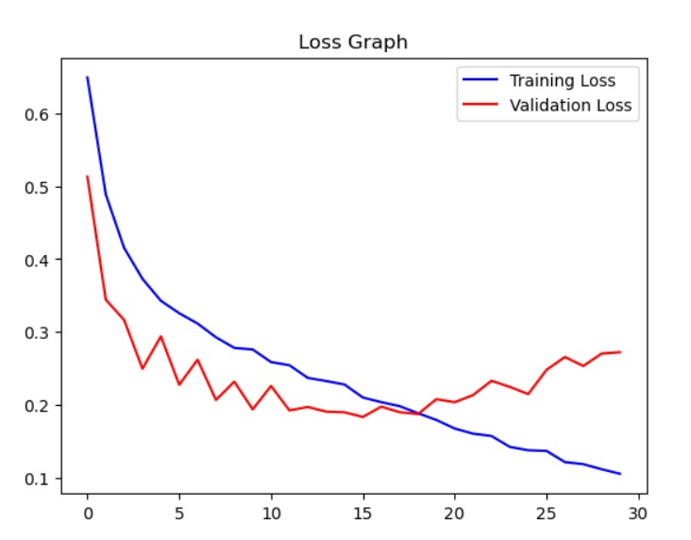
ACCURARCY AND LOSS GRAPH

Slide 15
CONCLUSION
In conclusion, deep learning models have proven to be an effective approach for age and gender detection. These models can automatically detect and classify gender and age groups with high accuracy. The utilization of convolutional neural networks has helped to improve the performance of these models significantly.

Slide 16
REFERENCES
https://www.hindawi.com/journals/cmmm/2022/1413597/
https://www.analyticsvidhya.com/blog/2021/07/age-and-gender-detection-using-deep-learning/
https://www.cameralyze.co/blog/age-gender-detection-top-use-cases
https://www.geeksforgeeks.org/age-detection-using-deep-learning-in-opencv/

Slide 17
THANK YOU

